Slide 1
Module 7 Privacy and Ethics
Bill Howe, UW
1

Slide 2
Learning Objectives
Why protecting sensitive data is hard, and why common techniques don’t work
Understanding differential privacy, a leading contender for protecting private data
Limitations of technical solutions, human judgment, and codes of ethics

Slide 3
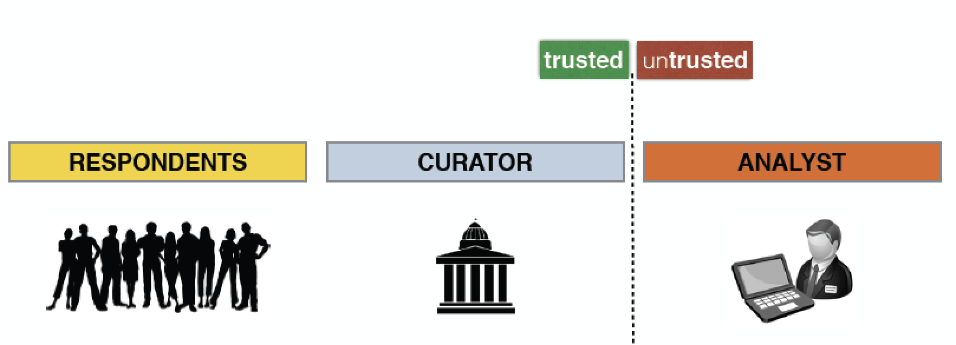
Typical Setting
respondents in the population seek protection of their personal data
the curator is trusted to collect data and is responsible for safely releasing it
the analyst is untrusted and wants to gain the most accurate insights into the population
src: Gerome Miklau

Slide 4
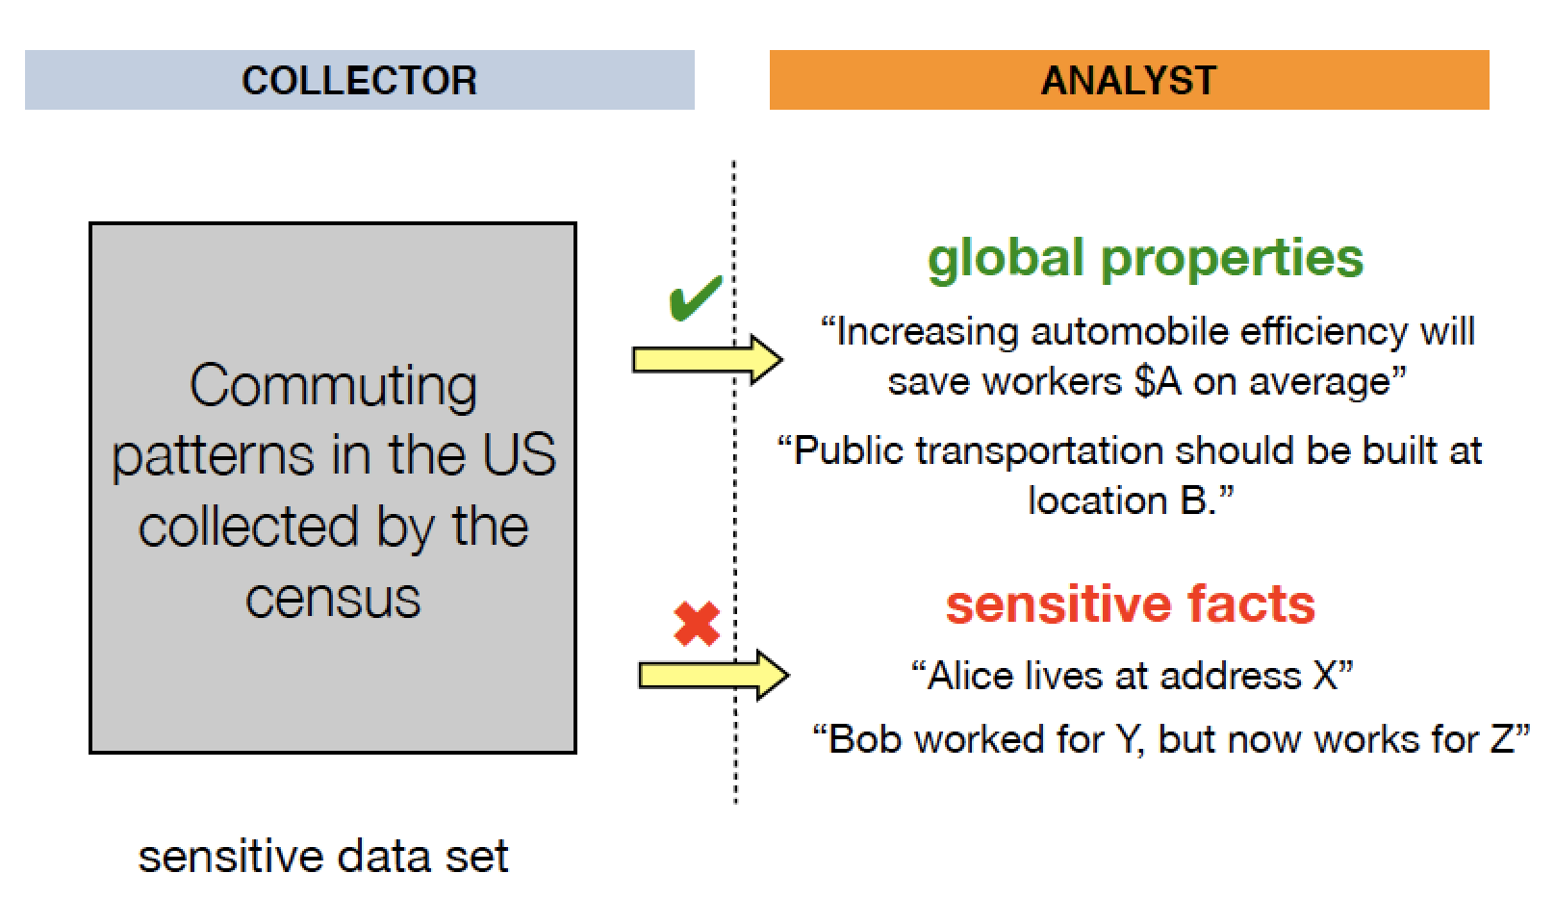
Example: Census data

Slide 5
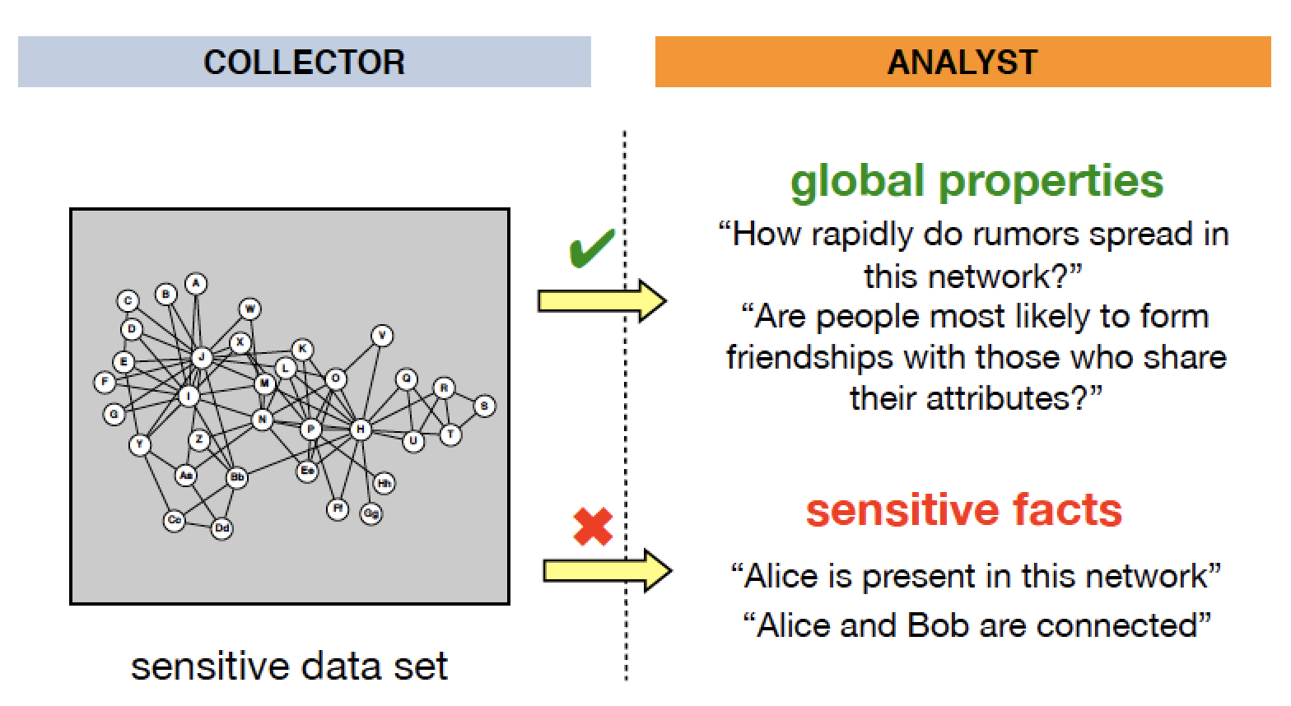
Example: Social Networks

Slide 6
One idea: Anonymization
Remove “personally identifying information”
Widely used for sharing urban data, and often legally justified
Why doesn’t this work?

Slide 7
Example: MA Governor identified in an “anonymized” medical database
In 1997, Massachusetts Group Insurance Commission released "anonymized" data on state employees that showed every single hospital visit!
Latanya Sweeney, a grad student, sought to show the ineffectiveness of this “anonymization.”
She knew that Governor Weld resided in Cambridge, Massachusetts, a city of 54,000 residents and seven ZIP codes.
For twenty dollars, she purchased the complete voter rolls from the city of Cambridge, a database containing, among other things, the name, address, ZIP code, birth date, and sex of every voter.
Only six people in Cambridge shared his birth date, only three of them men, and of them, only he lived in his ZIP code.
Follow up: ZIP code, birthdate, and sex sufficient to identify 87% of Americans!
http://arstechnica.com/tech-­policy/2009/09/your-­secrets-­live-­online-­in-­databases-­of-­

Slide 8
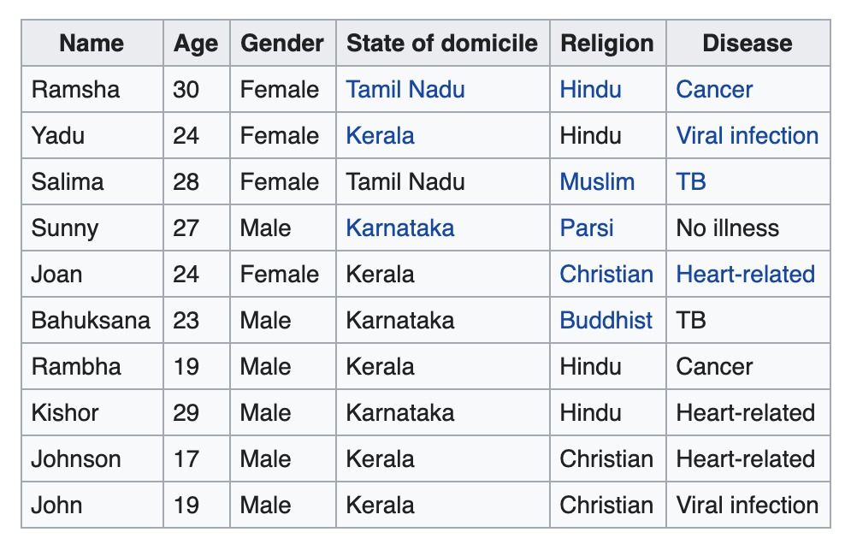
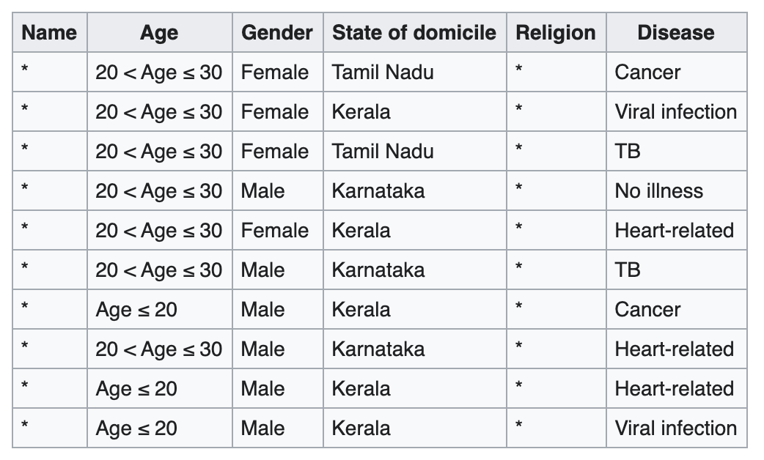
Another Attempt: Aggregation
Aggregate individuals into groups and release only groups
Formalized and studied (for tables) as k-anonymity
A release of data is said to have the k-anonymity property if the information for each person contained in the release cannot be distinguished from at least k individuals whose information also appear.
Raw data
Grouped data

Slide 9
Aggregation is extremely popular for releasing sensitive urban data. But it doesn’t work well.
Consider trajectory data: timeseries of locations for many individuals
4 aggregated points can distinguish 95% of the population (Montoye et al, 2013)
Aggregate into large regions:
“(lat,lon)” becomes “region x”
“9:13:23 am” becomes “9am-10am
Number of aggregated locations needed to uniquely identify people (green) or achieve 2-anonymity (blue)
At most 11 points required to identify everyone.
Unique in the Crowd: The privacy bounds of human mobility
Yves-Alexandre de Montjoye, César A. Hidalgo, Michel Verleysen & Vincent D. Blondel, Scientific Reports volume 3, Article number: 1376 (2013)

Slide 10
Example: Netflix Prize dataset
Netflix Prize dataset: Movie preferences by user released to spur a movie recommendation data science competition.
Remove all personally identifiable information
Have we protected privacy?Why?
adapted from WANG Yuxian

Slide 11
De-anonymizing Netflix data
With large probability, no two profiles are similar up to 𝜖. In Netflix data, no two records are more than 50% similar
If the profile can be matched up to 50% similarity to a profile in, say, IMDB, then the adversary knows with good chance the true identity of the profile.
Narayanan and V. Shmatikov, “Robust de-­anonymization of large sparse datasets (how to break anonymity of the netflix prize dataset),” in Proc. 29th IEEE Symposium on Security and Privacy, 2008.
WANG Yuxiang

Slide 12

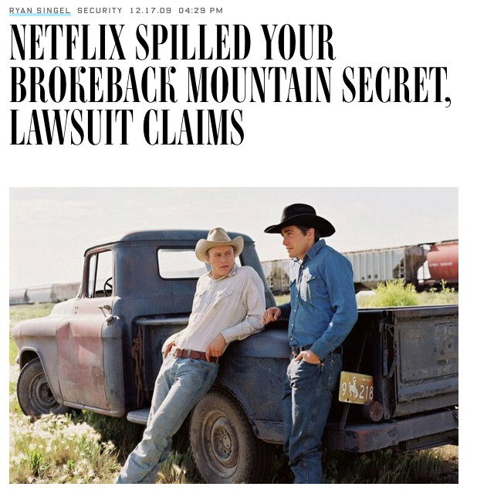
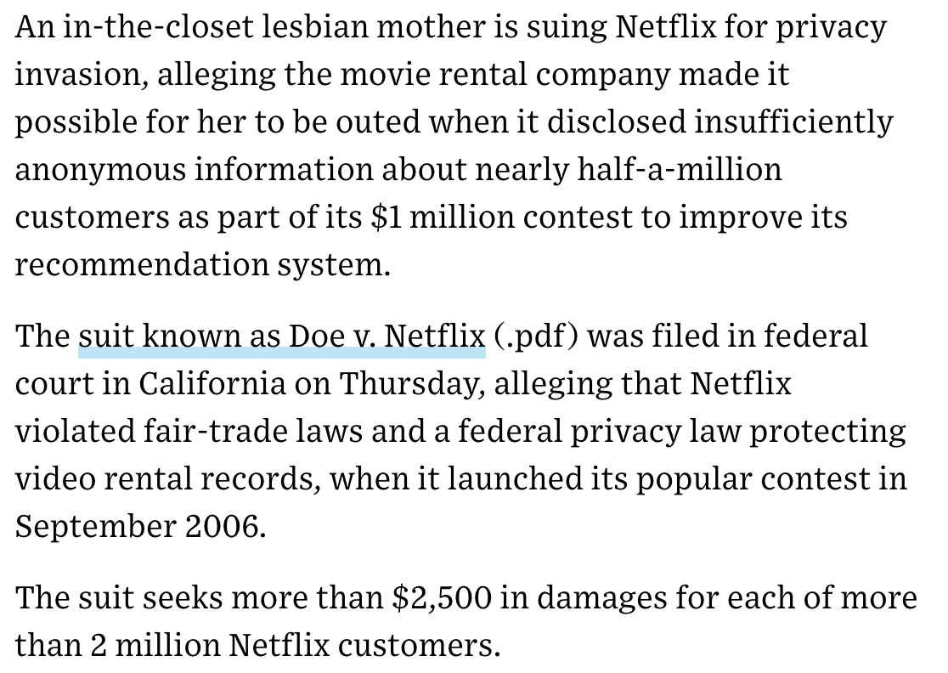

Slide 13
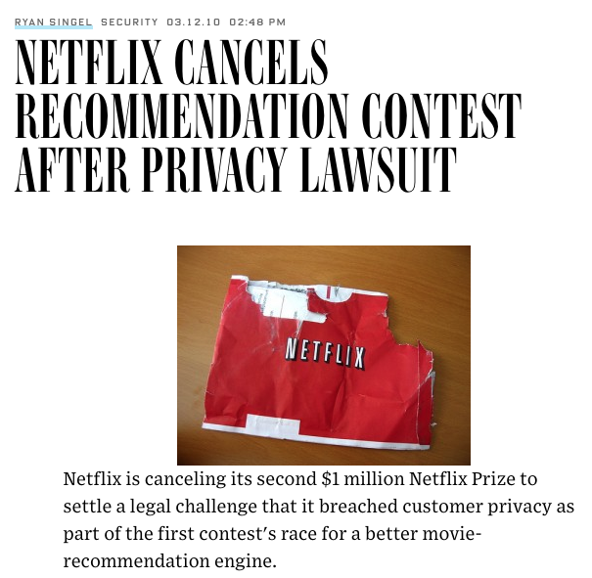

Slide 14
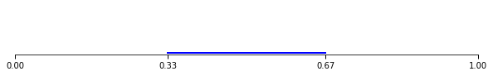
High-dimensional data is always sparse (1/4)
1-dimensional data
1/3 of feature space = 1/3 of input space
https://towardsdatascience.com/the-curse-of-dimensionality-f07c66128fe1

Slide 15
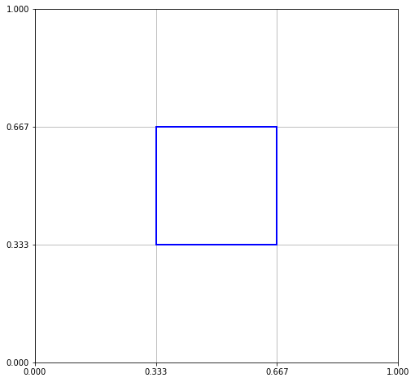
High-dimensional data is always sparse (2/4)
2-dimensional data
1/3 of each feature space = 1/9 of input space
https://towardsdatascience.com/the-curse-of-dimensionality-f07c66128fe1

Slide 16
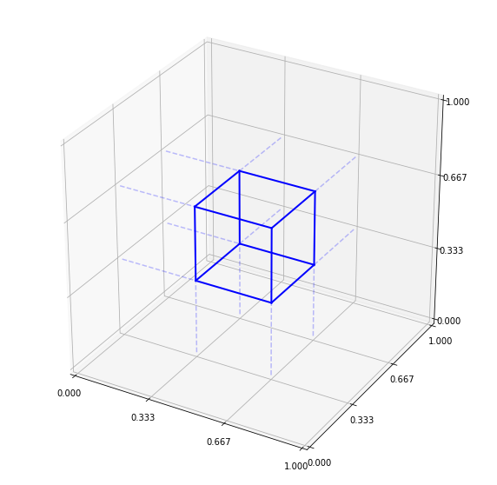
High-dimensional data is always sparse (3/4)
3-dimensional data
1/3 of each feature space = 1/27 of input space
https://towardsdatascience.com/the-curse-of-dimensionality-f07c66128fe1

Slide 17
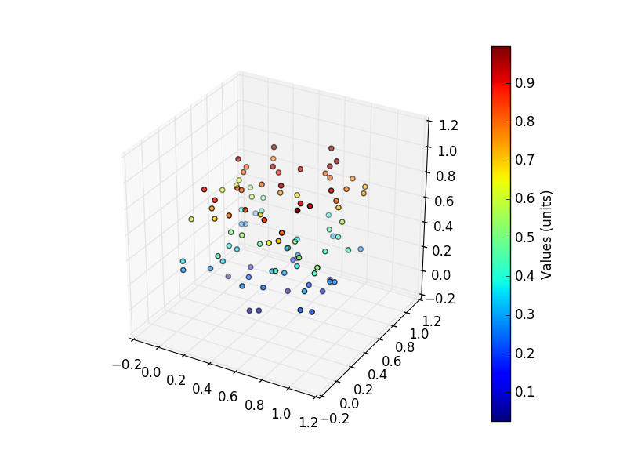
Curse of dimensionality (4/4)
20-dimensional data
1/3 of each feature space = 1/3486784401 of input space!
What this means:
Every data point is far away from every other point!
Every point is likely to be in its own box
With a few queries, we can single out anyone

Slide 18
Netflix data
17000 dimensions!
User1, movie1, movie2, movie3, …, movie17000
12345, 4, 0, 3, …, 5
54321, 0, 1, 0, …, 4

Slide 19
Worth repeating:
As the number of dimensions increases, everything becomes further apart
No two people are really all that similar in their movie preferences – there are a lot of movies
No two documents look exactly the same – there are a lot of words
K-anonymity completely fails on high-dim data [1]
Netflix: We would need to ignore most of the movies to achieve even 2-anonymity. The data would be useless!
[1] Charu C. Aggarwal, On k-anonymity and the curse of dimensionality, VLDB 05

Slide 20
The Fundamental Law of Information Recovery
“Overly accurate” estimates of “too many” statistics is blatantly non-private
Examples:
average income at the city block level (only one house on the block?)
average income by age (only one 32 year old in the dataset?)
DinurNissim03; DworkMcSherryTalwar07; DworkYekhanin08, De12, MuthukrishnanNikolov12,…

Slide 21
Differencing Attack
Example: (1) X: count the number of HIV-positive people in D; (2) Y: count the number of HIV-positive people in D not named Freddie; (3) X - Y tells you whether Freddie is HIV-positive
Example: (1) X: count the number of HIV-positive people in D; (2) Y: count the number of HIV-positive people in D not named Freddie; (3) X - Y tells you whether Freddie is HIV-positive
total amount spent by all customers on a given day, and the total amount spent by the subgroup of customers using a loyalty card.

Slide 22
Another Attempt: Control the questions one may ask
A basic differencing attack: (1) X: count the number of HIV-positive people in D; (2) Y: count the number of HIV-positive people in D not named Freddie; (3) X - Y tells you whether Freddie is HIV-positive
An idea: Monitor the queries; each query is granted or denied depending on what other queries were answered in the past
You asked about HIV-positive people, so we deny your query for HIV-positive people not-named Freddie
But: Refusal to respond to a query may itself be disclosive
And: Some formulations of this problem are computationally infeasible
Overall: It’s too hard to get right
[Kleinberg, Papadimitriou, Raghavan, PODS 2000]

Slide 23
Summary so far
Sampling: doesn’t protect anyone in the sample
Anonymization: We can use the other attributes to identify you anyway (zipcode, etc.)
Aggregation: Fails in high-dimensional data, and all the interesting datasets are high-dim (transportation, Netflix)
Control the queries: very hard to get right, and often provably infeasible
You see combinations of all these methods in practice, but none really provide reliable protection!

Slide 24
Two recurring features of privacy failures
High-dimensional data to distinguish individuals
Linkage with auxiliary data for re-identification

Slide 25
Differential Privacy

Slide 26
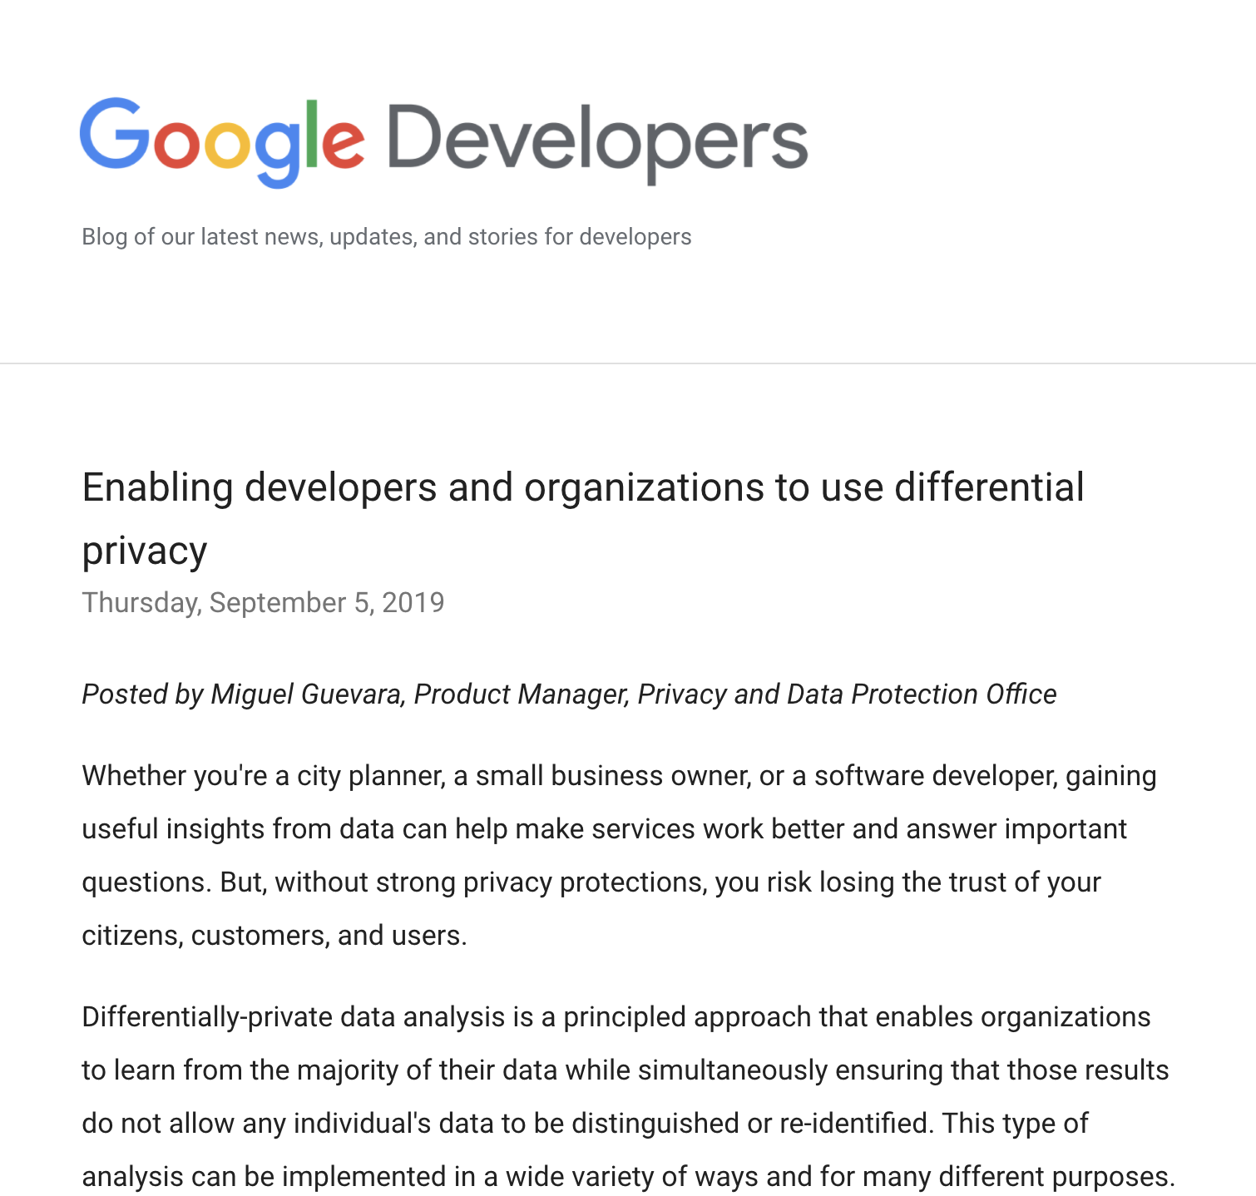
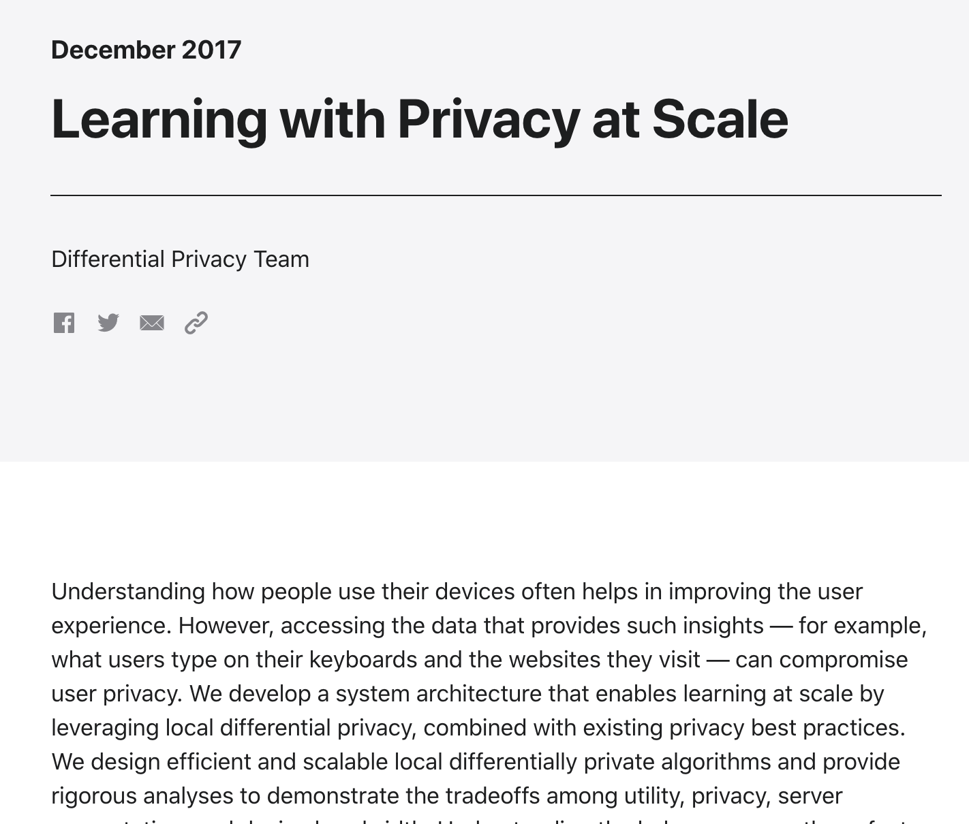

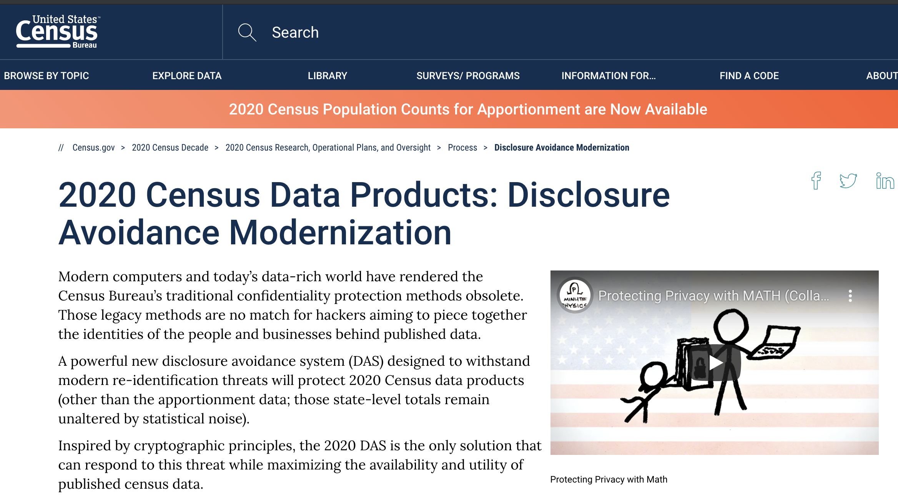
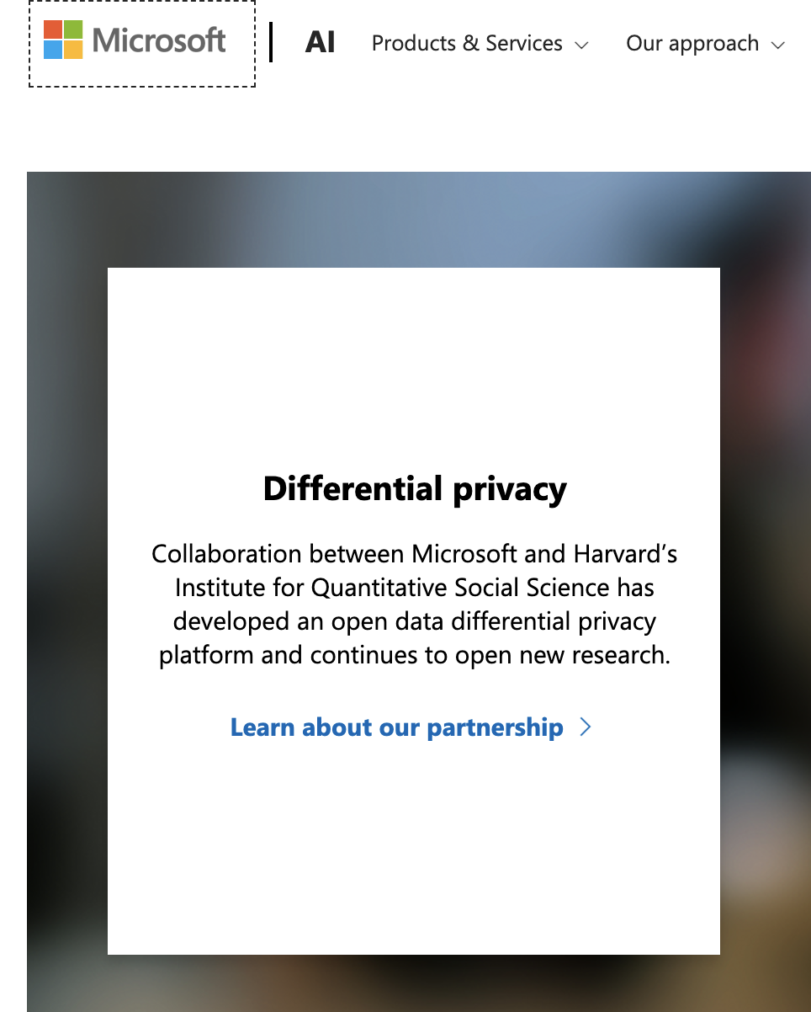
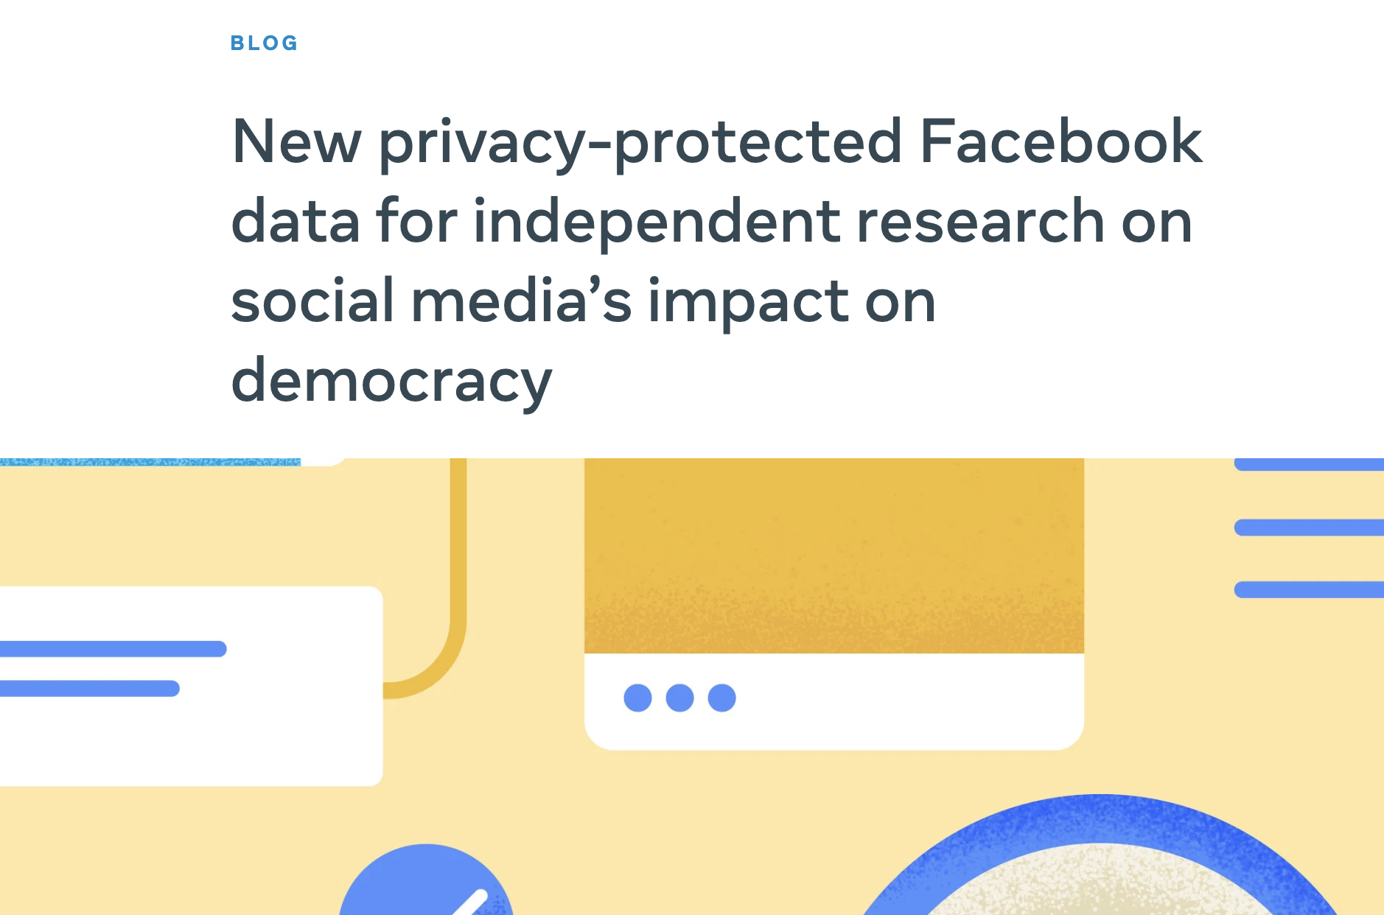


Slide 27
Last Attempt: Differential privacy: Adjust the answers to hide the sources
What kind of promise can the curator make to a respondent that ensures they won’t incur harms when the analyst releases global statistics?

Slide 28
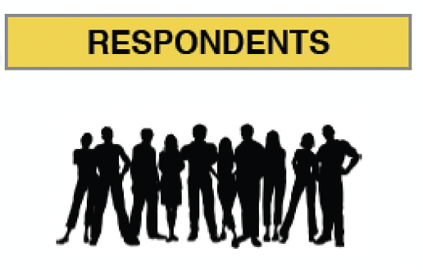


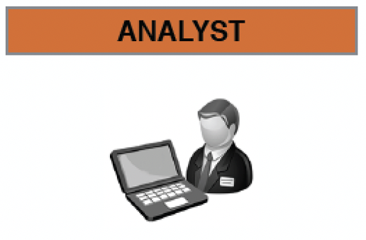



Describing the context more precisely….
Population of Interest
Aggregated data
Public
Q? Result
Q(D_{I}) = R
d_{i}
D_{I} = {d_{i} | i I}
Pop
I Pop
adapted from Christine Task

Slide 29
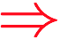

First attempt
I don’t mind if sketchycompany.com has my data if I could be sure that for any query anyone else might ask, my data would not affect the results.
Q(D_{(I-­me)}) = Q(D_{I})
Is this possible?
No: If my data had no effect, then no one’s data would have any effect, and the results would be useless.
Q(D_{(I-­me)}) = Q(D_{I})
Q(D_{I}) = Q( D )
adapted from Christine Task

Slide 30
First attempt restated
“If the release of statistics S makes it possible to determine the value [of private information] more accurately than is possible without access to S, a disclosure has taken place.”
Dalenius, 1977
It is not possible to achieve this strong notion of privacy!

Slide 31
Another idea
So we can’t promise that my data won’t affect the results
And we can’t promise that an attacker won’t be able to learn new information about me from looking at the results.
What if we promise that your information will not affect the result “much”?
If the result R were just about as likely to occur with or without your data, you might as well provide it.

Slide 32






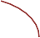

Differential Privacy
Given result R, is it possible to guess which world we are in?
If not, then we can argue that you won’t be harmed.
Result R
Result R
Possible world where my data is included in D
Possible world where my data is NOT included in D
Cynthia Dwork, 2011 (and many related)
slide adapted from Christine Task

Slide 33
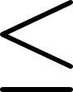
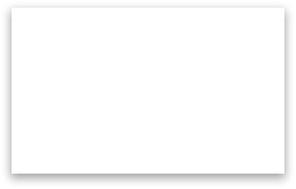

Differential Privacy
Pr(Q(D_{I})=R)
for all populations I, individuals i, and results R
some constant
Pr(Q(D_{I-i}) = R)
Pr(Q(D_{I})=R)
Result R
Pr(Q(D_{I-i})=R)
Possible world where my data is included in D
Possible world where my data is NOT included in D
Cynthia Dwork, 2011 (and many related)
slide adapted from Christine Task

Slide 34
Differential Privacy
Differential Privacy is a guarantee from the data collector to the individuals in the dataset about a particular randomized query.
The chance that the noisy, publicized result produced by the randomized query Q will be R is "about the same" whether or not you include your data.
Pr(Q(D_{I}) = R)
A
for all I, i, R
Pr(Q(D_{I} ) = R)
±i
Q is the privatized (randomized) query
A is a value close to 1.
– If A is large, no privacy is provided. If A = 1, then the data has no utility.
We define A = e^{𝜖} for some small 𝜖 > 0
Cynthia Dwork, 2011 (and many related)

Slide 35
Differential Privacy
Pr(Q(D_{I})=R)
e^{𝜖}
for all populations I, individuals i, and results R
Pr(Q(D_{I-i}) = R)
Pr(Q(D_{I})=R)
Result R
Pr(Q(D_{I-i})=R)
Possible world where my data is included in D
Possible world where my data is NOT included in D
Cynthia Dwork, 2011 (and many related)
slide adapted from Christine Task

Slide 36
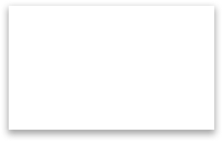



Say we ask “How many students drink on weekends?”
For this query, the difference in R between these two possible worlds is at most 1.
Result R
41 students drink on weekends
40 students drink on weekends
Possible world where my data is included in D
Possible world where my data is NOT included in D
Cynthia Dwork, 2011 (and many related)
slide adapted from Christine Task

Slide 37
Say we ask “How many students drink on weekends?”
What if we add a little random noise to this result?
Select a random number between -1 and 1, and add it to the true result.
Then we’ll get an answer between 39 and 41.
We haven’t affected the results “much,” but everyone has plausible deniability
41 students drink on weekends
40 students drink on weekends
Possible world where my data is included in D
Possible world where my data is NOT included in D
Cynthia Dwork, 2011 (and many related)
slide adapted from Christine Task

Slide 38
Generalizing
Consider all “neighboring” datasets D1, D2. “Neighboring” means they differ in just one record. These are our two “possible worlds”
Then given a query F that returns a single number, the global sensitivity of F is
ΔF = max |F(D1) - F(D2)|
D1, D2
This is the maximum difference we might find across
all possible pairs of neighboring datasets.

Slide 39
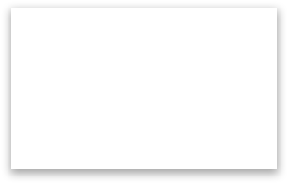

Say we ask “How many students drink on weekends?”
For any two neighboring datasets D1, D2, the difference in this simple count query is at most 1
Δ F = max |F(D1) — F(D2)|
D1, D2
Result R
41 students drink on weekends
40 students drink on weekends
Possible world where my data is included in D
Possible world where my data is NOT included in D

Slide 40
We don’t just want one query….
How many students drink on weekends? How many students are on financial aid?
F =
This query returns a vector of results.
We need to consider the sum of the differences.
The sum of the absolute value of the differences is the L1 norm.
ΔF=max ||F(D1) — F(D2)||
D1, D2
L1

Slide 41
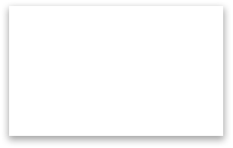
Say we ask “How many students drink on weekends?”
For any two neighboring datasets D1, D2, the sum of the differences is at most 2
ΔF=max ||F(D1)-F(D2)||
D1, D2
L1
Result R
Difference might be 0, 1, or
2. The maximum value is 2
41 students drink on weekends
62 students are on financial aid
40 students drink on weekends
61 students are on financial aid
Possible world where my data is included in D
Possible world where my data is NOT included in D

Slide 42
Many computations can be reduced to counts
Histograms
Singular value decompositions
Some decision trees
k-means clusterings
Association rules
A. Blum, C. Dwork, F. McSherry, and K. Nissim, Practical Privacy: The SuLQ framework, PODS, June 2005.

Slide 43
So how do we add noise?
The sensitivity is ΔF
We know we must add noise that is a function of this sensitivity.
The higher the sensitivity, the more we have to change the result to prevent an adversary from distinguishing between the two possible worlds.
What noise?
Simplest approach is to add Laplacian noise

Slide 44
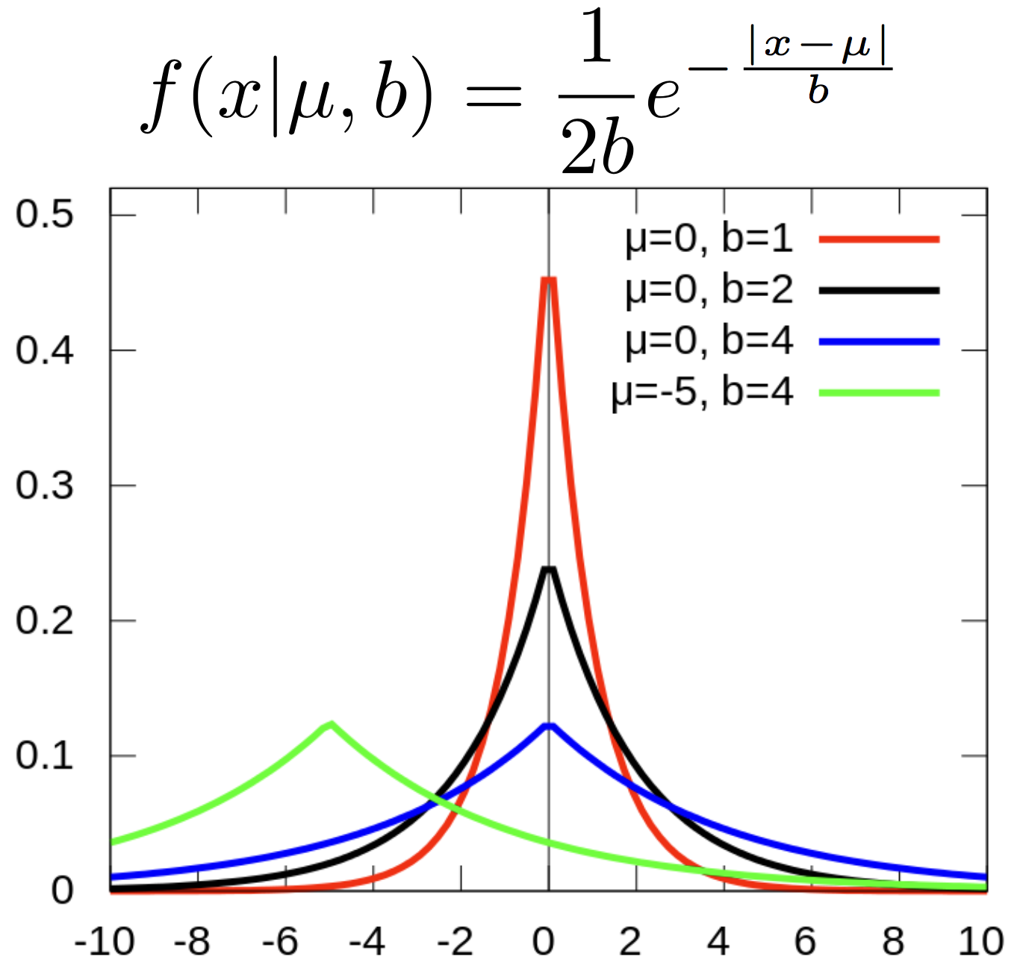
So how do we add noise? Laplacian
Lap(µ, b)
µ is the position
b
is the scale (the spread)
wikipedia

Slide 45
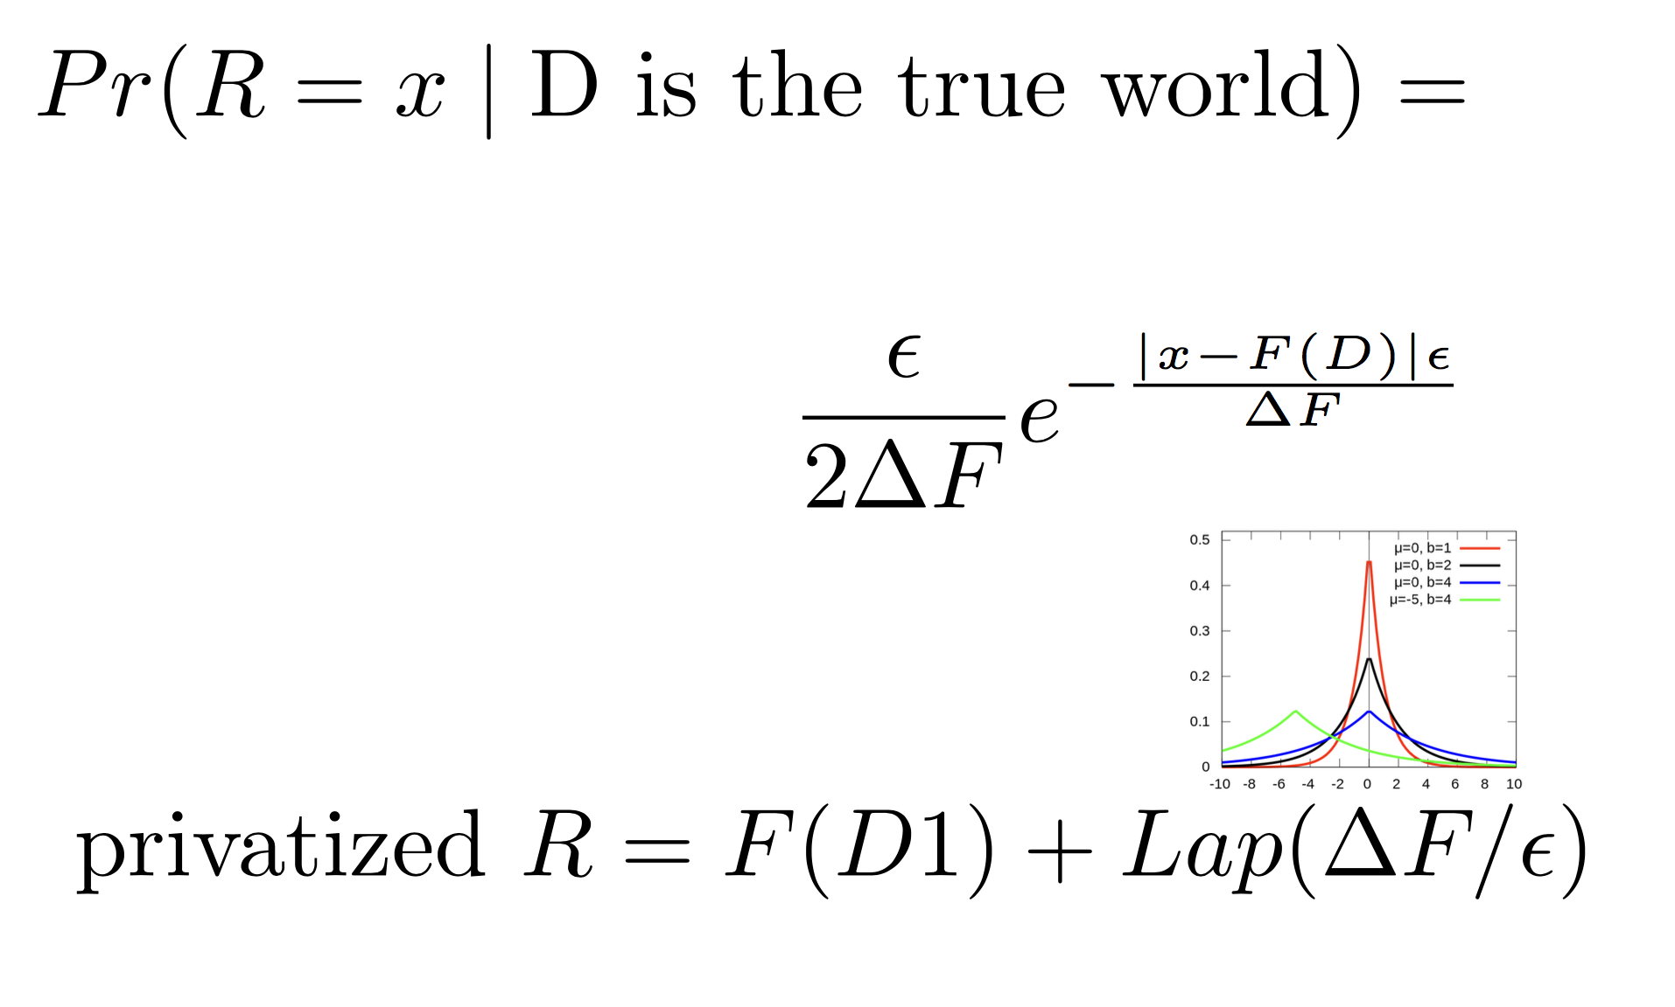
So how do we add noise?

Slide 46
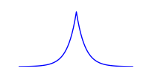
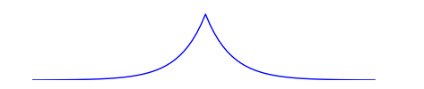
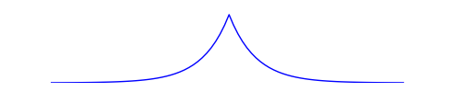
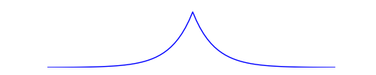
Intuition
R
D1 D2 D3 D4 D5 D6 D7
D8 D9 D10 D11 D12

Slide 47
Problems with Differential Privacy (1):
Best for low-sensitivity queries
Count (and generalizations of count, such as histograms) work well, because the presence or absence of a single record can only change the result slightly
Sums can be a problem. Consider the question “what is the total income earned by men vs. women?” A single very-high- income individual could change the result by an enormous amount, so you’d have to add a lot of noise for this worst-case individual
Max is even worse, since the result is independent of the size of the dataset.

Slide 48
Problems with Differential Privacy (2): Adaptive querying exposes more privacy
If I ask a series of differentially private queries, I can disambiguate between possible worlds. So we have to add even more noise to the results.
We think in terms of a “privacy budget.” After a series of queries exhausts the privacy budget, that’s it! You have to kill the user.
Example: Laplacian noise to each result.
If we want to keep the original guarantee across k queries, we must inject k times the noise. When k is large, this destroys utility of the output
Various approaches exist to do better for special types of queries, which in some cases must be known up-front (the “non-interactive” case). But the concept of the privacy budget is fundamental to DP.

Slide 49
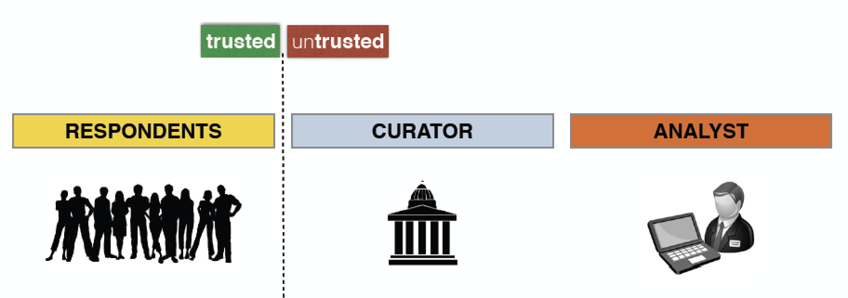
Some Solutions to DP Problems
Time-varying data:
If you evict old data as new data comes in, you can refresh your privacy budget.
Local differential privacy: (Duchi 13)
As data is collected, randomize the response
respondents contribute their personal data
the curator is untrusted, collects data, releases it to analysts
the analyst is untrusted, extracts value from data

Slide 50
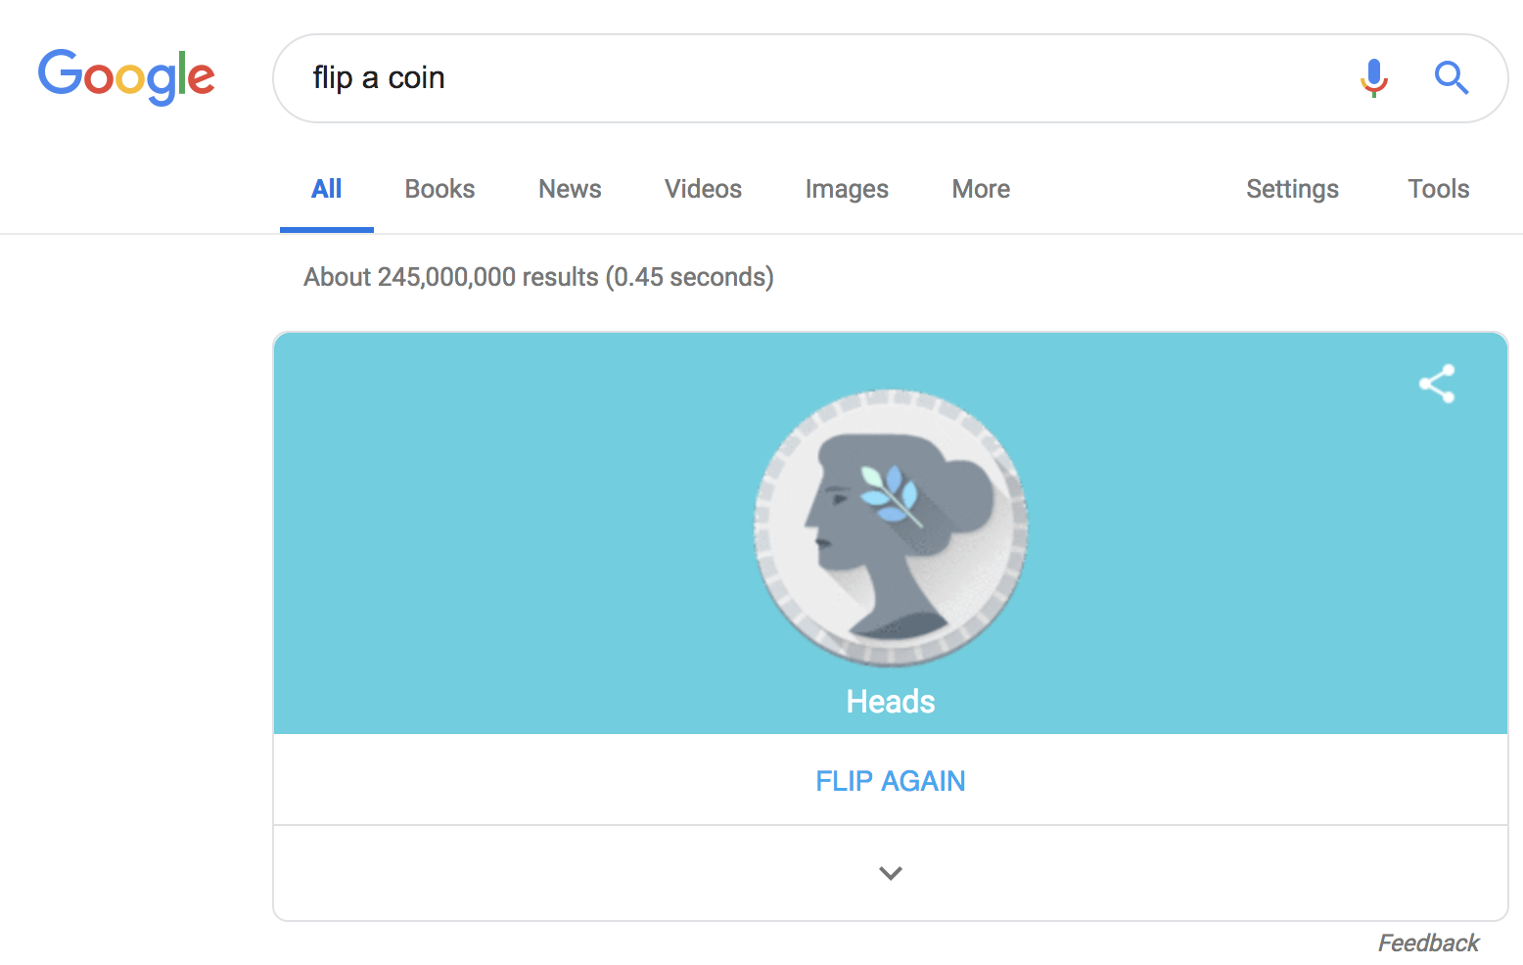
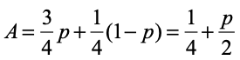
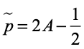
Randomized Response: an old approach to local differential privacy
Did you get vaccinated?
let’s call this property P (Truth=Yes) and estimate p, the fraction of the class for whom P holds
flip a coin C1
if C1 is tails, then respond truthfully
if C1 is heads, then flip another coin C2
if C2 is heads then Yes
else C2 is tails then respond No
the expected number of Yes answers is:
thus, we estimate p as:
Notes:
A “yes” response is either when (1) truth=yes and C1=tails, with a probability of p x1/2, or (2) both coins land heads, which occurs with probability 1/4. In case (2), we have 1/4 x p people for whom truth = yes and 1/4 x (1-p) people for whom truth = no.

Slide 51
Did you get vaccinated?
let’s call this property P (Truth=Yes) and estimate p, the fraction of the class for whom P holds
flip a coin C1
if C1 is tails, then respond truthfully
if C1 is heads, then flip another coin C2
if C2 is heads then Yes
else C2 is tails then respond No
}
randomization - adding noise - is what gives plausible deniability
a process privacy method
the expected number of Yes answers is:
privacy comes from plausible deniability

Slide 52
Exercise
I’ll ask you a true/false question
Note the true answer (1 or 0)
Flip a coin
If tails, enter the true answer
If heads, flip a coin
If heads, respond 1
If tails, respond 0

Slide 53
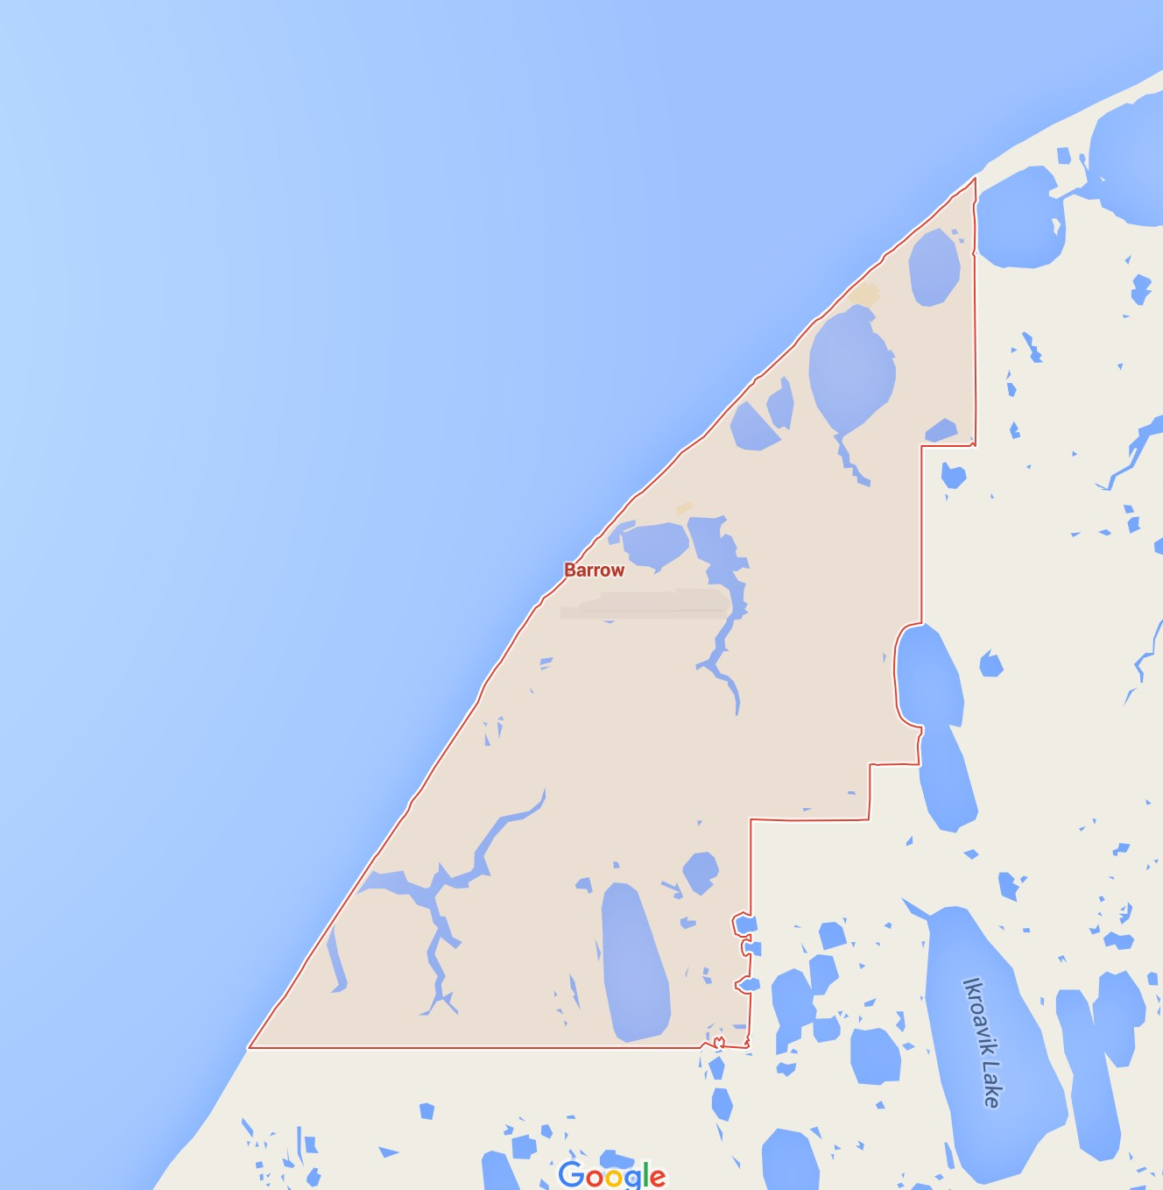
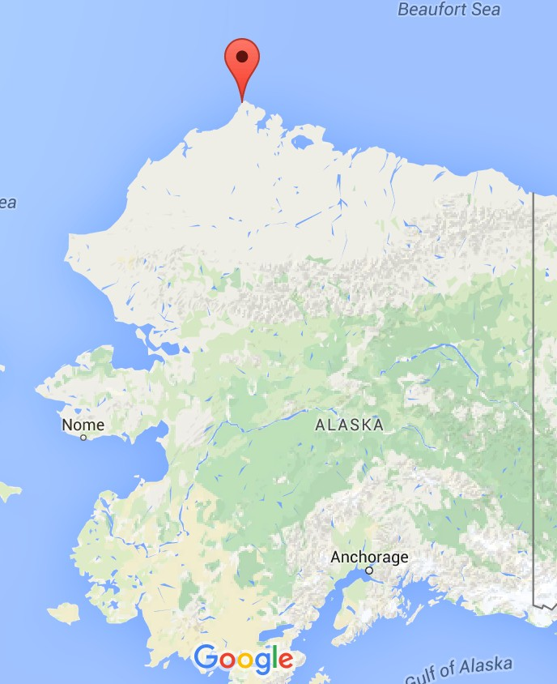
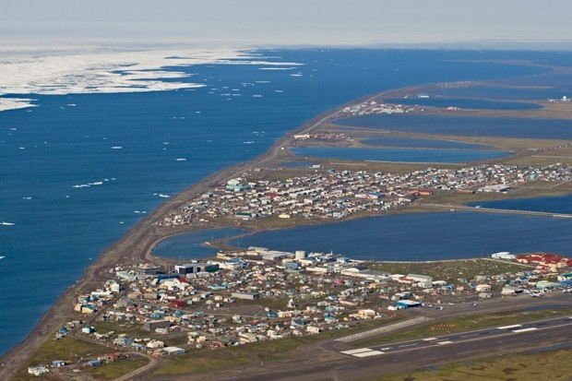
Alcohol Study, Barrow Alaska, 1979
Native leaders and city officials, worried about drinking and associated violence in their community invited a group of sociology researchers to assess the problem and work with them to devise solutions.

Slide 54
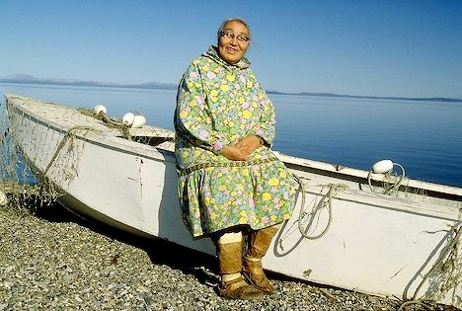
Methods
10% representative sample (N=88) of everyone over the age of 15 using a 1972 demographic survey
Interviewed on attitudes and values about use of alcohol
Obtained psychological histories including drinking behavior
Given the Michigan Alcoholism Screening Test (Seltzer, 1971)
Asked to draw a picture of a person
– Used to determine cultural identity

Slide 55
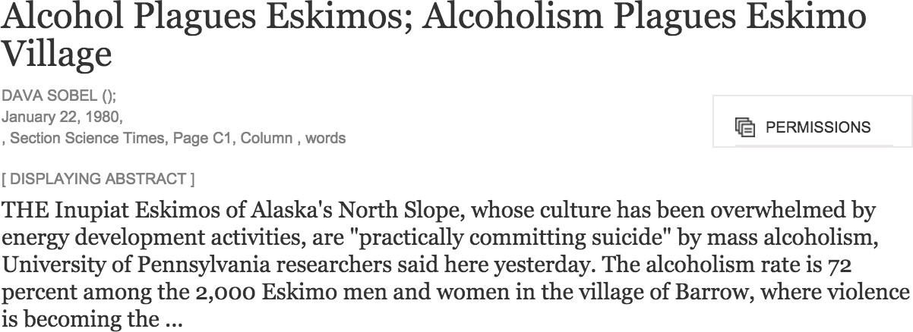
Results announced unilaterally and publicly
At the conclusion of the study researchers formulated a report entitled “The Inupiat, Economics and Alcohol on the Alaskan North Slope” which was released simultaneously at a press release and to the Barrow community. The press release was picked up by the New York Times, who ran a front page story entitled Alcohol Plagues Eskimos

Slide 56
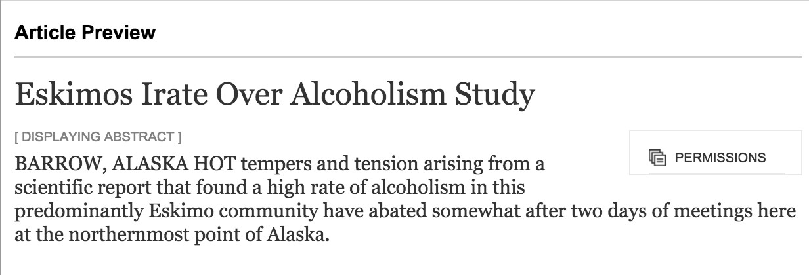
Backlash
The results of the Barrow Alcohol Study in Alaska were revealed in the context of a press conference that was held far from the Native village, and without the presence, much less the knowledge or consent, of any community member who might have been able to present any context concerning the socioeconomic conditions of the village. Study results suggested that nearly all adults in the community were alcoholics. In addition to the shame felt by community members, the town’s Standard and Poor bond rating suffered as a result, which in turn decreased the tribe’s ability to secure funding for much needed projects.
Research has been described as “probably one of the dirtiest words in the indigenous world’s vocabulary”

Slide 57
Problems: Methodological
“The authors once again met with the Barrow Technical Advisory Group, who stated their concern that only Natives were studied, and that outsiders in town had not been included.”
“The estimates of the frequency of intoxication based on association with the probability of being detained were termed "ludicrous, both logically and statistically.””
Edward F. Foulks, M.D., Misalliances In The Barrow Alcohol

Slide 58
Problems: Ethical
Participants were not in control of their data nor the context in which they were presented.
Easy to demonstrate specific, significant harms:
Social: Stigmatizing
Financial: Bond rating lowered
How could these problems have been avoided?
After all, the study revealed no personally identifiable information, which is a focus of the privacy discussion
Even those who did not participate in the study incurred harm!

Slide 59
Two Topics
Social Component: Codes of Conduct
Technical Component: Differential Privacy

Slide 60
CODES OF CONDUCT FOR DATA SCIENCE

Slide 61
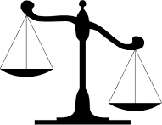
Social: Ethical principles vs. ethical rules
In the Barrow example, ethical rules were generally followed
But ethical principles were violated: The researchers appear to have placed their own interests ahead of those of the research subjects, the client, and society

Slide 62
Principles: Codes of Conduct
American Statistical Association
http://www.amstat.org/committees/ethics/
Certified Analytics Professional
https://www.certifiedanalytics.org/ethics.php
Data Science Association
http://www.datascienceassn.org/code-of- conduct.html

Slide 63
American Statistical Association
Professionalism
Responsibilities to Funders, Clients, Employers
Responsibilities in Publications and Testimony
Responsibilities to Research Subjects
Responsibilities to Research Team Colleagues
Responsibilities to Other Statisticians or Statistical Practitioners
Responsibilities Regarding Allegations of Misconduct
Responsibilities of Employers
http://www.amstat.org/committees/ethics/

Slide 64
Data Science Association Code of Conduct
(Terms and Definition)
Competence
Do what you client asks, unless it violates law
Communication with clients
Confidential information
Conflicts of interest
(More on conflicts of interest and confidentiality)
Scientific integrity
Misconduct (follow the rules)
http://www.datascienceassn.org/code-­of-­conduct.html

Slide 65
Certified Analytics Professional
To whom are data scientists responsible?
Employers and Clients
Colleagues
Research Subjects
Society
Not necessarily in this order…
https://www.certifiedanalytics.org/ethics.php

